Slide 1
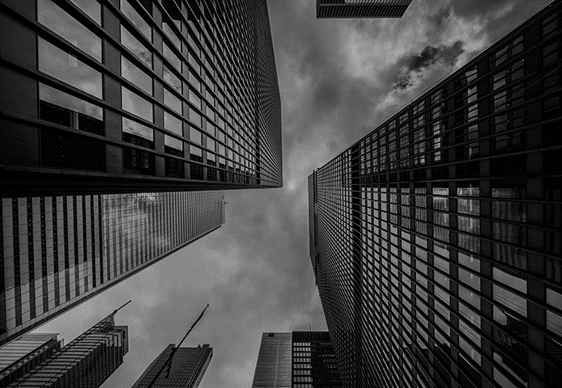

What is your Name?
My name is Mohammad Yehya and I am a Student of FAST NUCES.

Slide 2
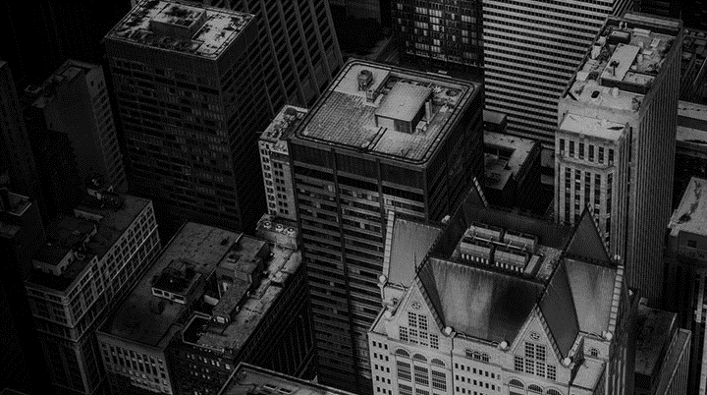
Where were you born?
I was born in Karachi.

Slide 3
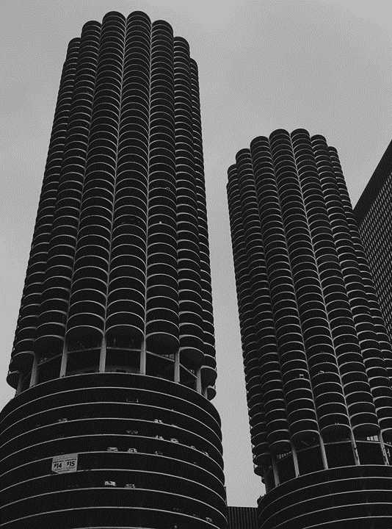
What is your favorite color? What is your eye color?
My favorite color is blue and my eye color is brown.

Slide 4

WHEN is your birthday?
My birthdate is 5/15/2003 and it is the international family day.

Slide 5
What is your favorite subject at university?
My favorite subject is physics as it helps me relate the things we learn to nature.

Slide 6
Where do you want to go to college?
I want to go to Highbrow college to complete my A Levels and to pursue a Major in CS.

Slide 7
What is your favorite genre of music?
I absolutely despise all music and do not listen to at all.

Slide 8
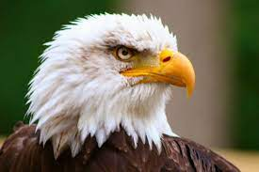
If you could be an animal, what would it be?
I would like to be eagle as they are smart, sharp, and strong. They are the rulers of the sky and I like being a ruler.

Slide 9
What is your favorite fast food Restaurant and why?
I do not eat fast food but if I really had to then I would just eat a pizza from Broadway.

Slide 10
What is your favorite holiday of the year?
My favorite holiday is the holiday of 12 Rabi-ul-Awal, as we celebrate the birth of out prophet.

Slide 11
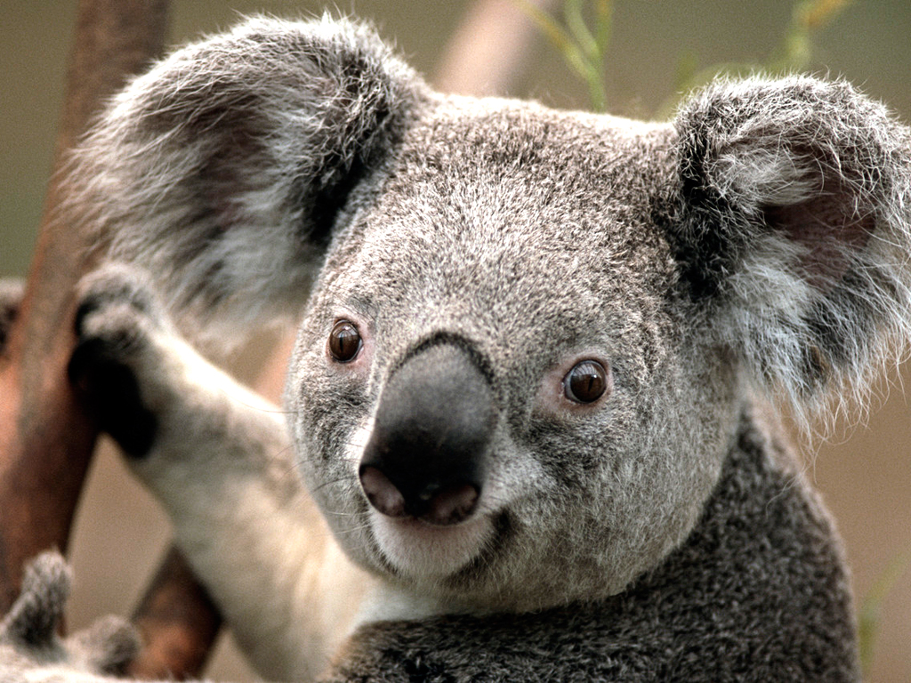
Citations:
Google.com

Slide 12
THE END

